Slide 1
Reinforcement Learning
Hyundai Motors Boot-campus
Ukjo Hwang, Dohyeok Kwon
Information and Intelligence Systems Lab.
Electronic Engineering, Hanyang University
July 7, 2025

Slide 2
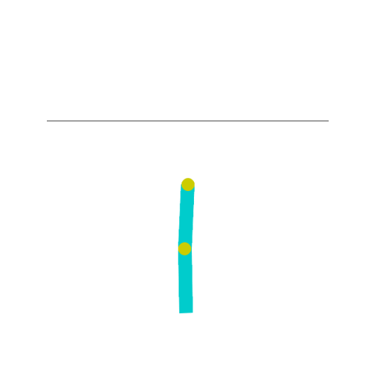
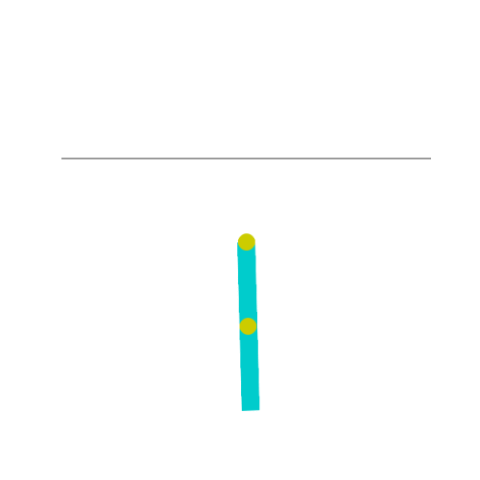
Goal
How to implement deep RL algorithms
How to utilize environments using the OpenAI Gym API
How to train neural networks for reinforcement learning tasks
How to train agents using DQN and DDPG algorithms

Slide 3
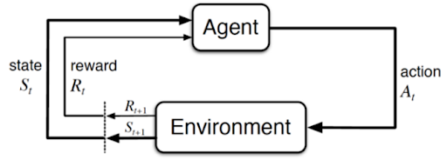
Environment Agent Interaction

Slide 4
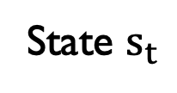
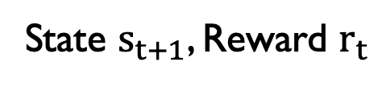
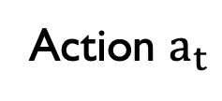
Environment Agent Interaction
Environment
Agent
State $s_{t}$
Action $a_{t}$
State $s_{t+1}$, Reward $r_{t}$
The environment provides the agent with information about the current state and reward.
The agent selects an action based on its policy.
The environment transitions to a new state according to its state transition probabilities.

Slide 5
Supervised Learning vs Reinforcement Learning
Supervised Learning
The data is provided in advance.
The distribution and quality of data are given beforehand.
Reinforcement Learning
The data is generated through interactions between the agent and the environment during the learning process
The distribution and quality of data continuously change according to the action (policy).
Data
Model
Environment
Agent

Slide 6
How to implement RL algorithms
Environment
What is the shape and structure of the data?
What functions and APIs does the environment provide?
Agent
How to design and implement the model (e.g., Neural Network)
How to train the model using the provided data
Combination
How the agent interacts with the environment
How to implement and apply specific RL algorithms

Slide 7
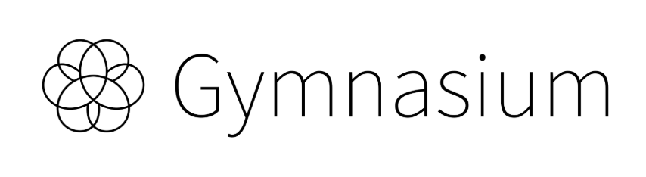
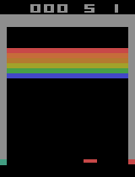
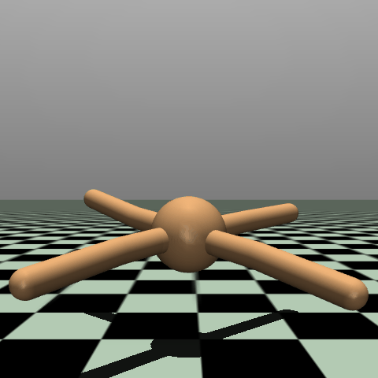
OpenAI Gymnasium
OpenAI Gymnasium
Provides a wide range of environments for RL.
It's important to understand the basic interface of Gymnasium.
To implement a new environment, it's best to follow the Gymnasium API standards.
https://gymnasium.farama.org/

Slide 8
Setup
I. Create Anaconda virtual environment
conda create –n hyundai_rl python=3.10
conda activate hyundai_rl
II. Install packages
pip install gymnasium matplotlib ipykernel torch

Slide 9
I. Q-Learning

Slide 10
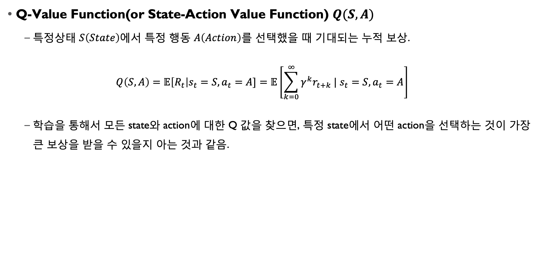
Background
Q-Value Function(or State-Action Value Function) $Q(S, A)$
특정상태 $S\left(State\right)$에서 특정 행동 $A\left(Action\right)$를 선택했을 때 기대되는 누적 보상.
$$Q\left(S, A\right)=𝔼\left[R_{t}\right|s_{t}=S, a_{t}=A]=𝔼\left[\sum_{k=0}^{∞}{γ^{k}r_{t+k} | s_{t}=S, a_{t}=A}\right]$$
학습을 통해서 모든 state와 action에 대한 Q 값을 찾으면, 특정 state에서 어떤 action을 선택하는 것이 가장 큰 보상을 받을 수 있을지 아는 것과 같음.

Slide 11
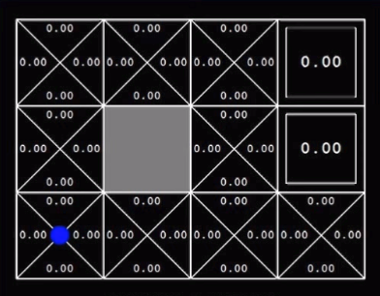
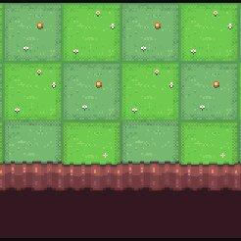
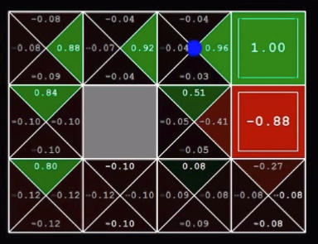
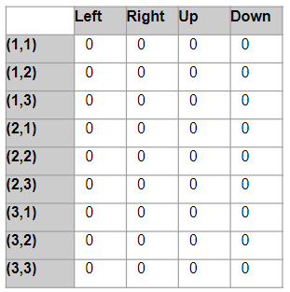
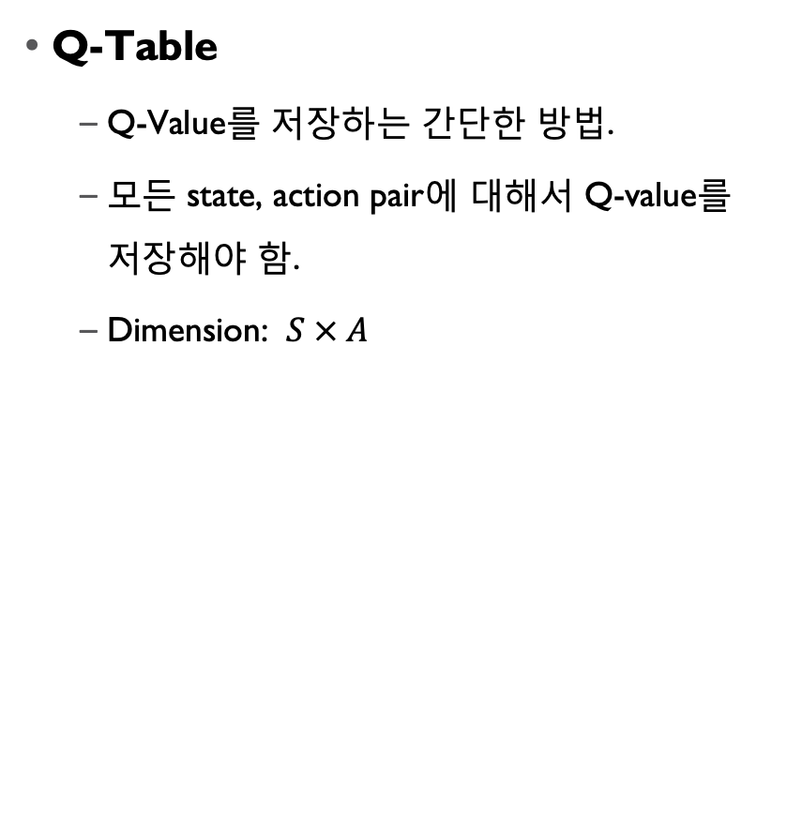
Background
Q-Table
Q-Value를 저장하는 간단한 방법.
모든 state, action pair에 대해서 Q-value를 저장해야 함.
Dimension: $S × A$

Slide 12
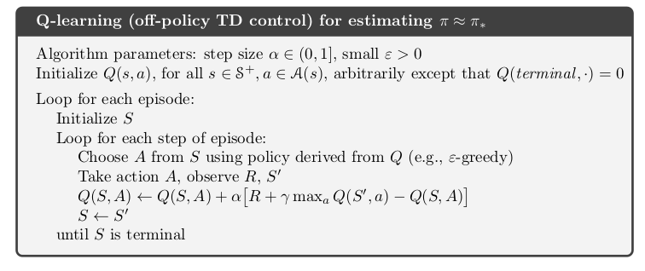
Q-Learning

Slide 13
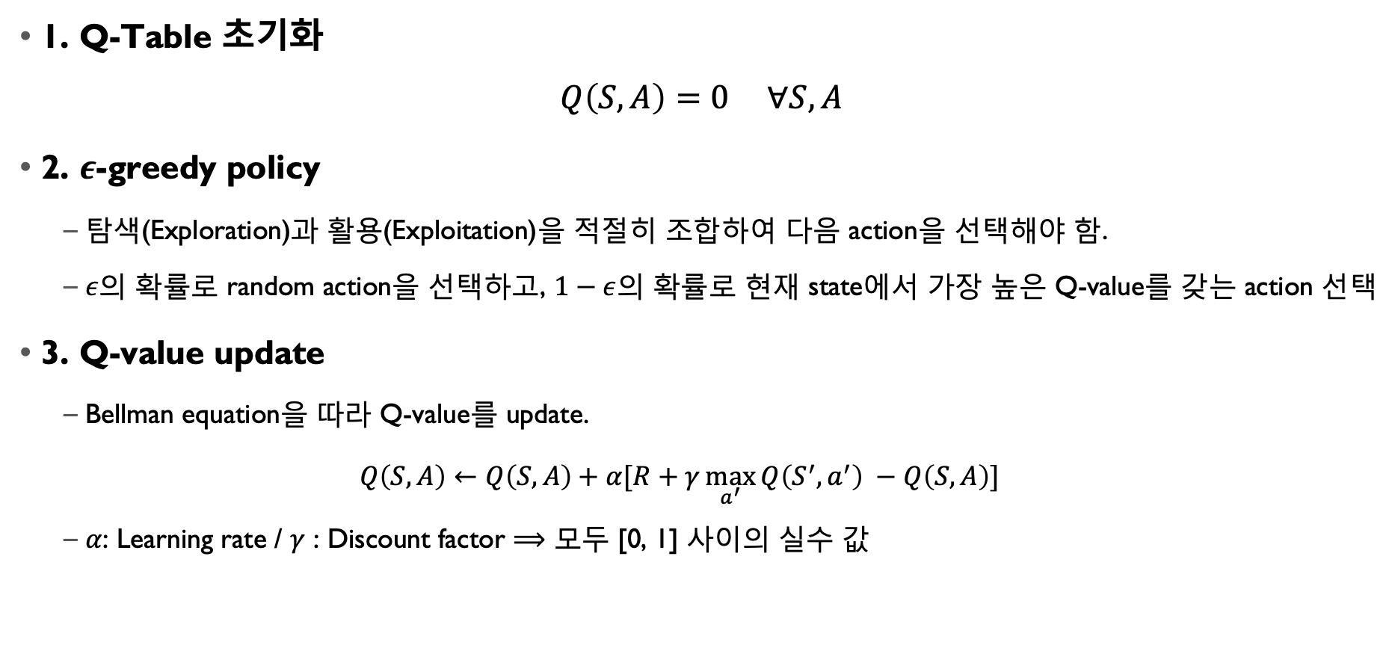
Q-Learning
1. Q-Table 초기화
$$Q\left(S, A\right)=0 ∀S, A$$
2. $ε$-greedy policy
탐색(Exploration)과 활용(Exploitation)을 적절히 조합하여 다음 action을 선택해야 함.
$ε$의 확률로 random action을 선택하고, $1−ε$의 확률로 현재 state에서 가장 높은 Q-value를 갖는 action 선택
3. Q-value update
Bellman equation을 따라 Q-value를 update.
$$Q\left(S, A\right)←Q\left(S, A\right)+α[R+γ\max_{a^{′}}{Q\left(S^{′}, a^{′}\right)} −Q\left(S, A\right)]$$
$α$: Learning rate / $γ$ : Discount factor $⟹$ 모두 [0, 1] 사이의 실수 값

Slide 14
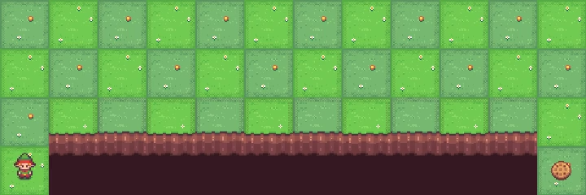
Env: Cliff Walking
Action Space: Discrete(4) | Observation Space: Discrete(48)
[Action] 0: Move up | 1: Move right | 2: Move down | 3: Move left
Starting State: [36] (3, 0) | Episode End: [47] (3, 11)
Reward
Each time step incurs -1 reward, unless the player stepped into the cliff, which incurs -100 reward.

Slide 15
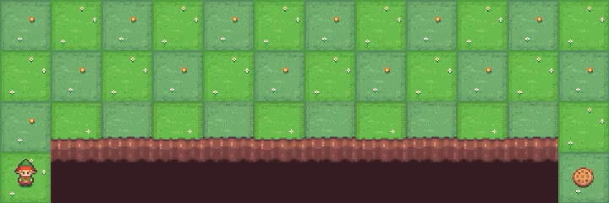
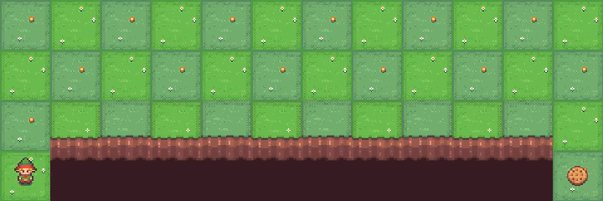

Env: Cliff Walking
[Training]
Episode 0~10 (Average steps: 240.0)
Episode 100~110 (Average steps: 38.5)
Episode 200~210 (Average steps: 17.1)

Slide 16
Experimental Extensions
Exploration probability 가 더 높은 값이라면?
Increase ‘exploration rate’: 0.1→ 0.4
Decrease ‘number of episodes’: 300 → 150
유사한 환경인 `FrozenLake`에서 학습에 더 많은 step이 필요한 이유?
env = gym.make('FrozenLake-v1', render_mode='rgb_array', is_slippery=False)
Increase episodes from 150 to 2000
Stochastic transition의 영향 확인
Set ‘is_slippery = True’

Slide 17
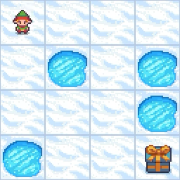
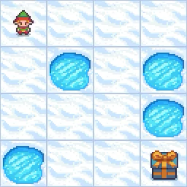
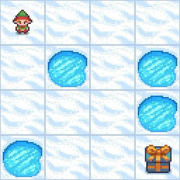
Experimental Extensions
Exploration probability 가 더 높은 값이라면?
유사한 환경인 `FrozenLake`에서 학습에 더 많은 step이 필요한 이유?
Stochastic transition의 영향 확인
= True’
1500
2000
Slippery

Slide 18
II. DQN

Slide 19
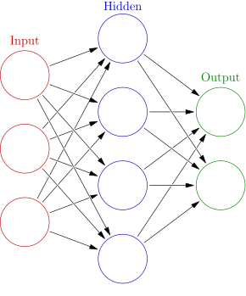
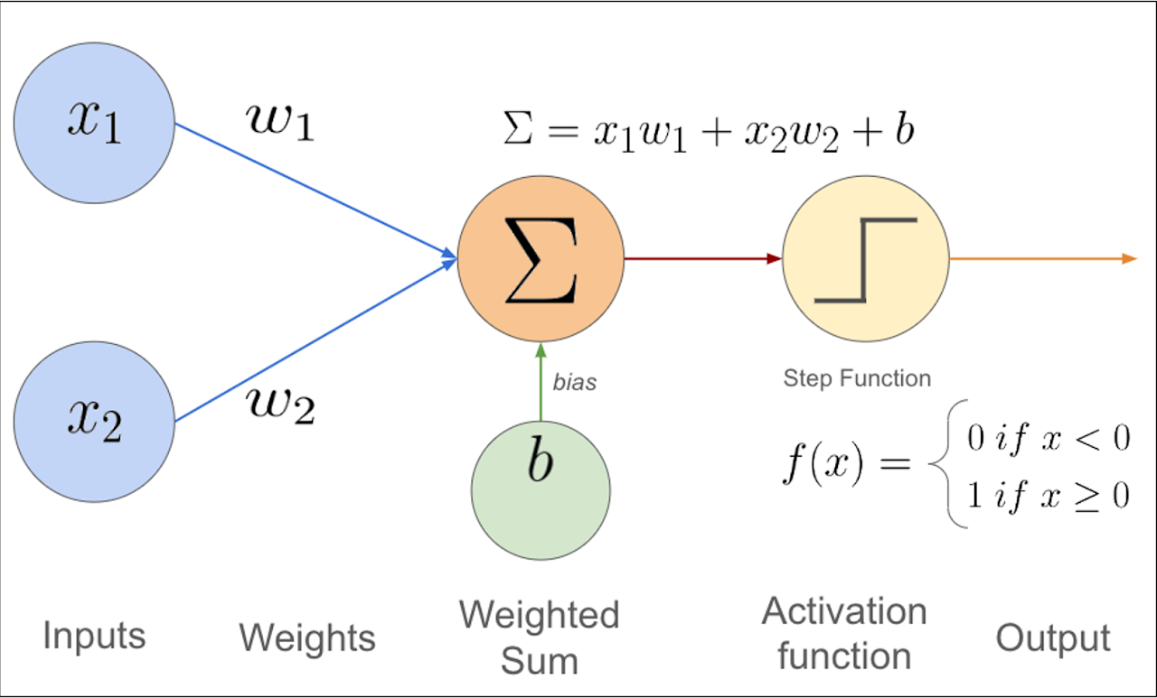
Deep Neural Networks
If the state and action spaces are large, it becomes impractical to implement the Q-function using a table.
Therefore, deep neural networks are widely used to approximate the Q-function.

Slide 20
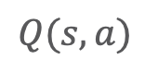
Q-Function
The output of the DNN is the Q-value corresponding to a given state-action pair.
Therefore, it is natural to design the DNN to take the state and action as input and output the corresponding Q-value.
Q Network
$$Q(s,a)$$
State s
Action a

Slide 21
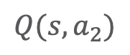
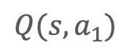
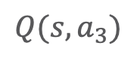
Q-Function
However, in practice, the DNN is often designed to take only the state as input and output the Q-values for every possible action.
The feasibility of this implementation relies on the discreteness of the action space.
Q Network
$$Q(s, a_{1})$$
$$Q(s, a_{2})$$
State s
$$Q(s, a_{3})$$

Slide 22
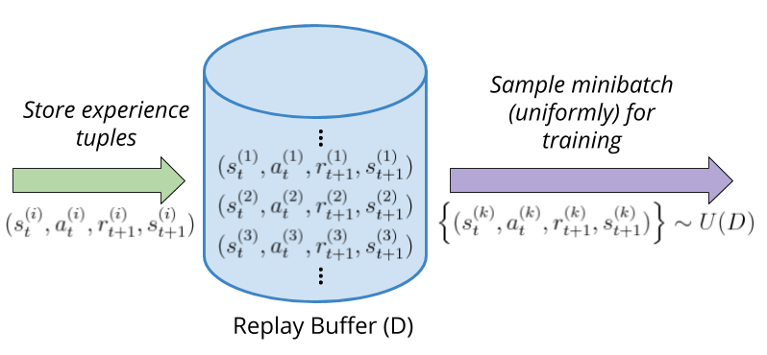
Implementation Details
Since DQN is an off-policy algorithm, it utilizes a replay buffer to store samples generated while interacting with the environment.
This design choice is crucial because it helps to reduce strong correlations between samples.

Slide 23
Implementation Details
DQN employs a target network that gradually updates to follow the parameters of the original network.
This mechanism contributes to stabilizing the training.

Slide 24
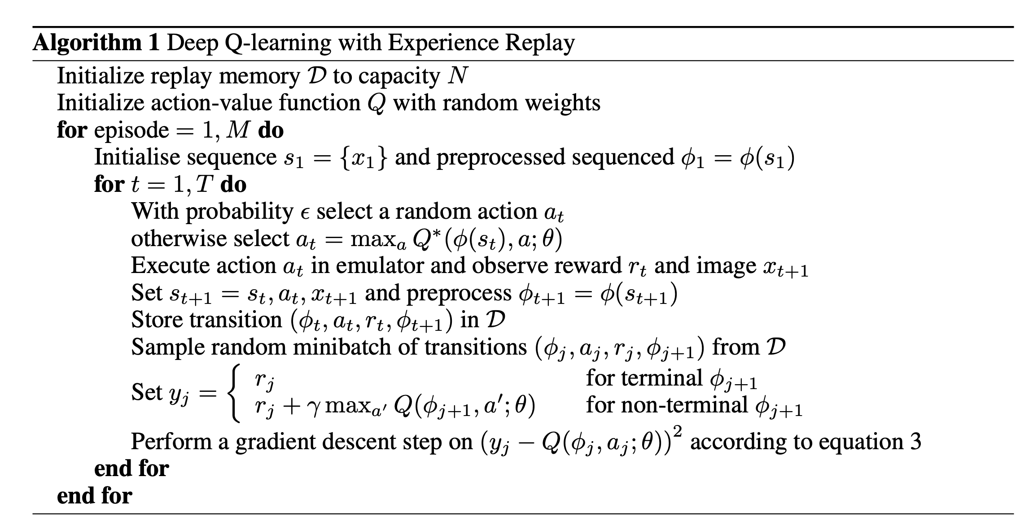
DQN Algorithm

Slide 25
III. Actor-Critic Algorithm

Slide 26
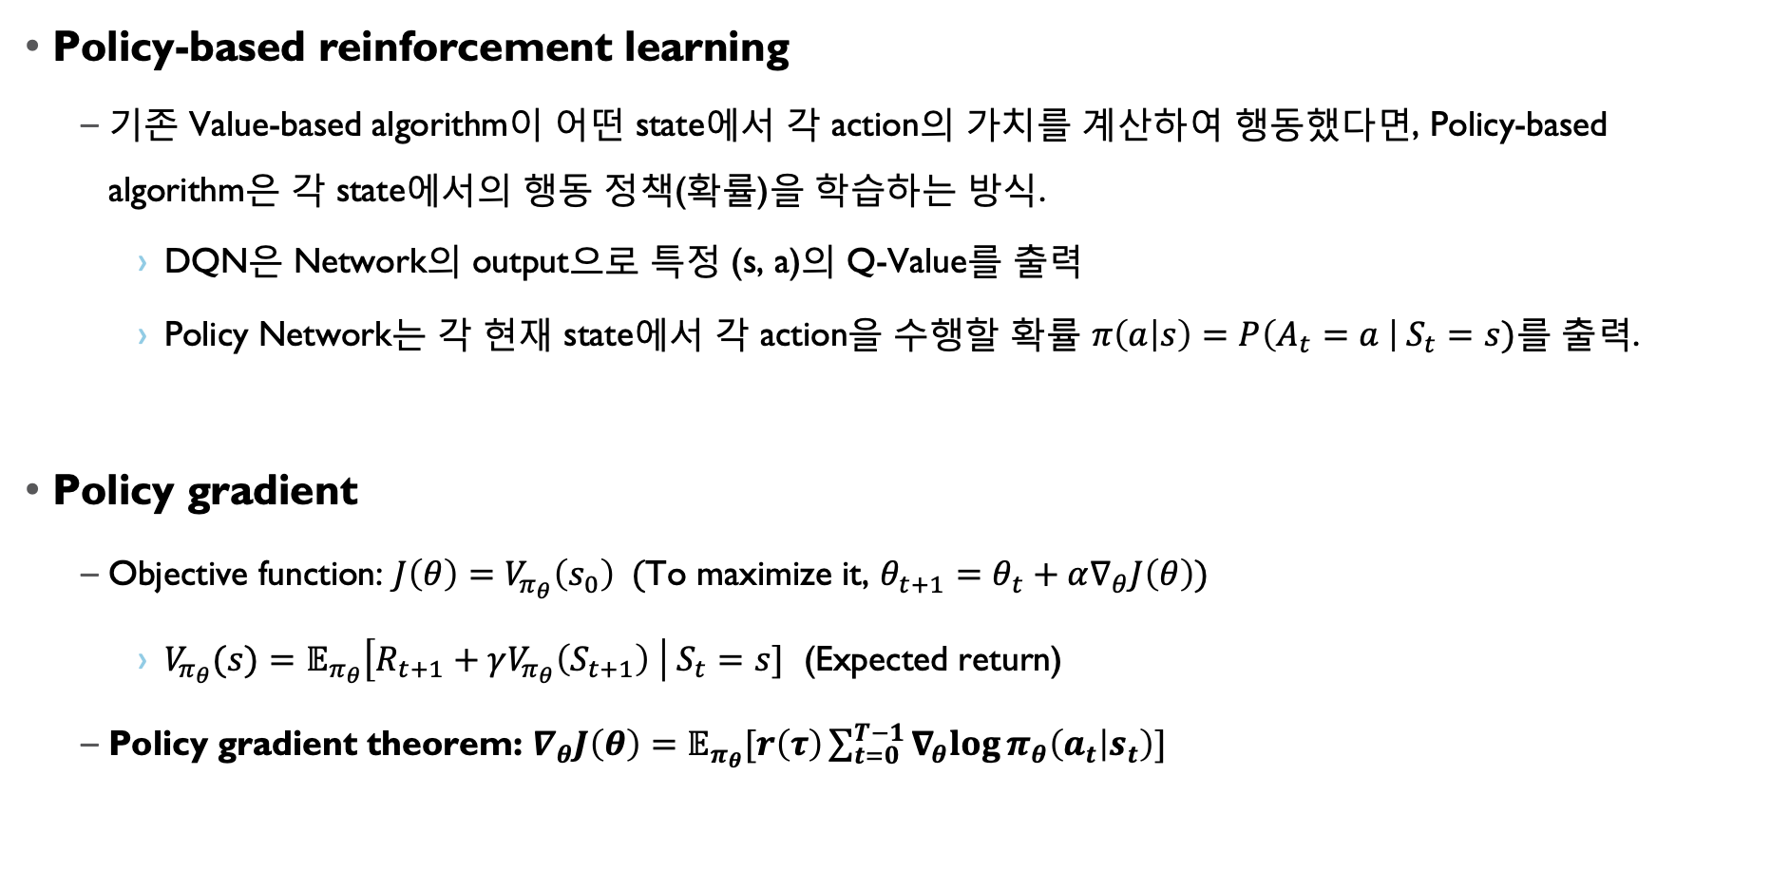
Background
Policy-based reinforcement learning
기존 Value-based algorithm이 어떤 state에서 각 action의 가치를 계산하여 행동했다면, Policy-based algorithm은 각 state에서의 행동 정책(확률)을 학습하는 방식.
DQN은 Network의 output으로 특정 (s, a)의 Q-Value를 출력
Policy Network는 각 현재 state에서 각 action을 수행할 확률 $π\left(a | s\right)=P\left(A_{t}=a \right| S_{t}=s)$를 출력.
Policy gradient
Objective function: $J\left(θ\right)=V_{π_{θ}}\left(s_{0}\right)$ (To maximize it, $θ_{t+1}=θ_{t}+α∇_{θ}J\left(θ\right)$)
$V_{π_{θ}}(s)=𝔼_{π_{θ}}\left[R_{t+1}+γV_{π_{θ}}\left(S_{t+1}\right) \right| S_{t}=s]$ (Expected return)
Policy gradient theorem: $∇_{θ}J\left(θ\right)=𝔼_{π_{θ}}[r\left(τ\right)\sum_{t=0}^{T−1}{∇_{θ}log}π_{θ}\left(a_{t} | s_{t}\right)]$

Slide 27
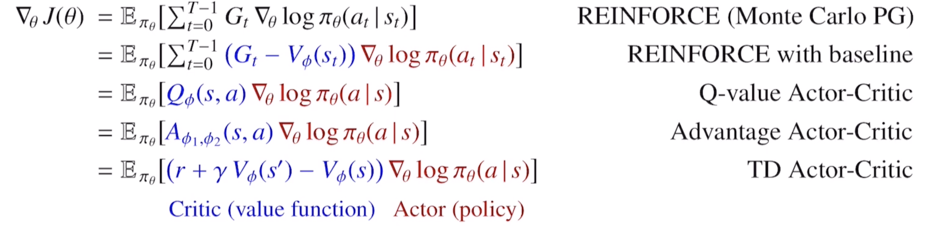
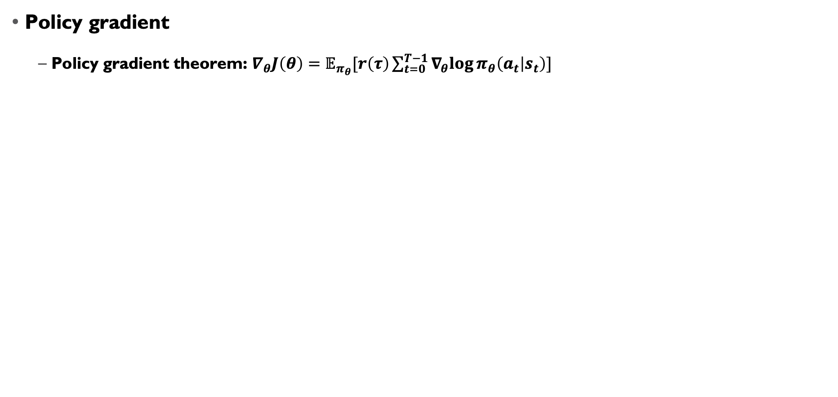
Background
Policy gradient
Policy gradient theorem: $∇_{θ}J\left(θ\right)=𝔼_{π_{θ}}[r\left(τ\right)\sum_{t=0}^{T−1}{∇_{θ}log}π_{θ}\left(a_{t} | s_{t}\right)]$

Slide 28
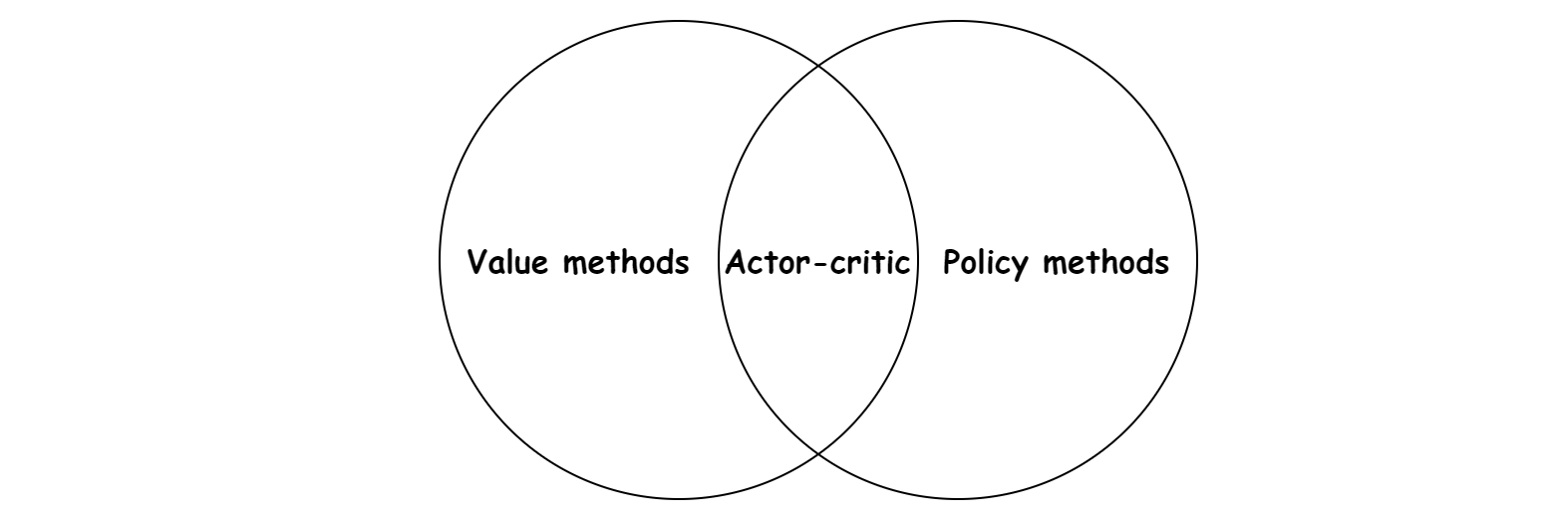
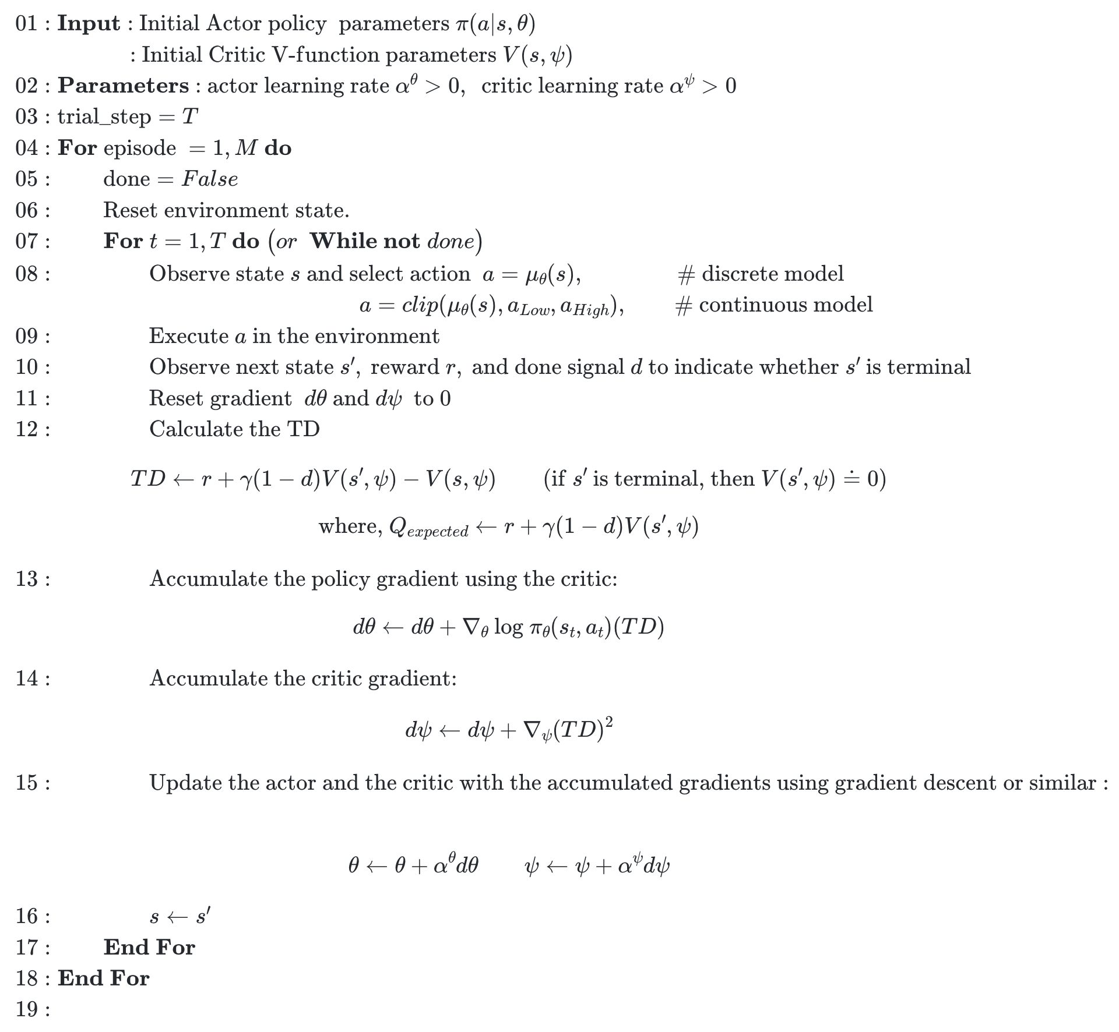
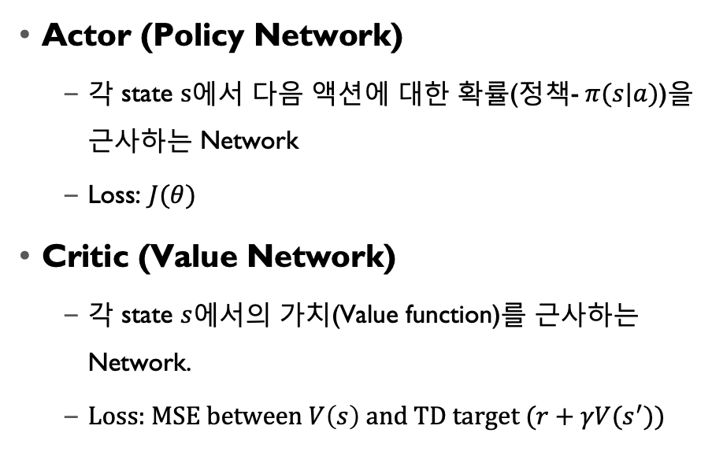
Actor-Critic
Actor (Policy Network)
각 state $s$에서 다음 액션에 대한 확률(정책-$π(s|a)$)을 근사하는 Network
Loss: $J(θ)$
Critic (Value Network)
각 state $s$에서의 가치(Value function)를 근사하는 Network.
Loss: MSE between $V\left(s\right)$ and TD target ($r+γV(s^{′})$)

Slide 29
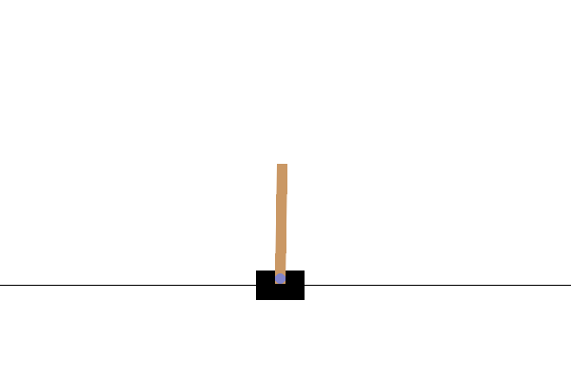
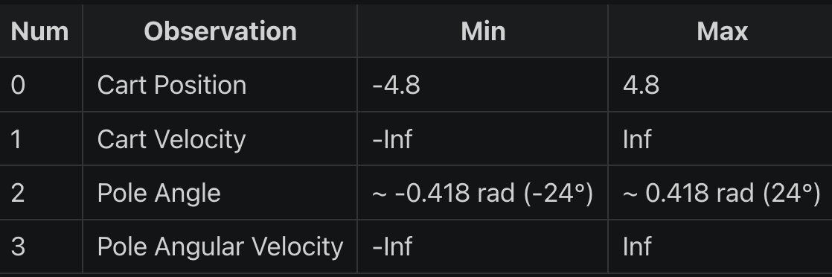
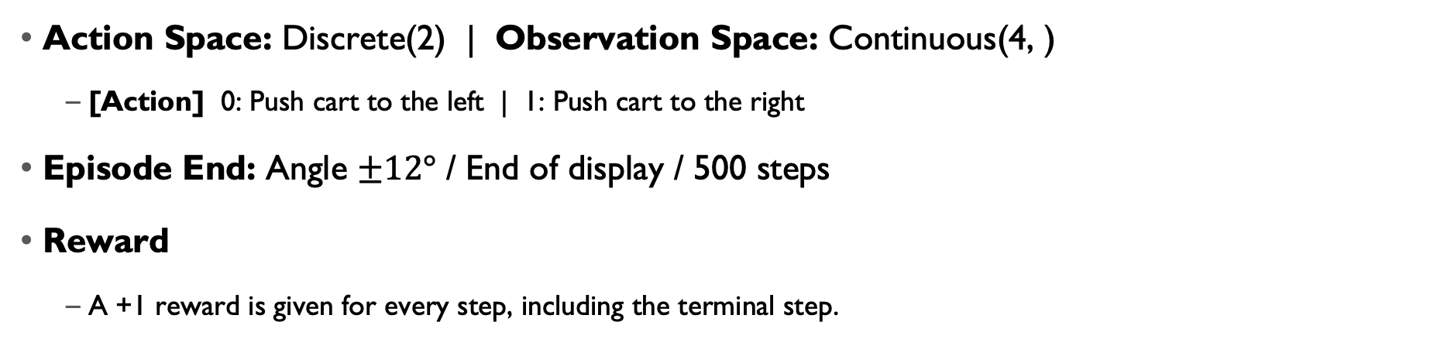
Env: Cart Pole
Action Space: Discrete(2) | Observation Space: Continuous(4, )
[Action] 0: Push cart to the left | 1: Push cart to the right
Episode End: Angle $±12°$ / End of display / 500 steps
Reward
A +1 reward is given for every step, including the terminal step.

Slide 30
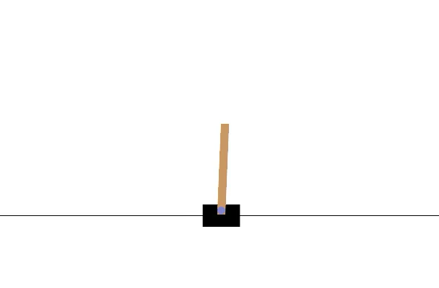
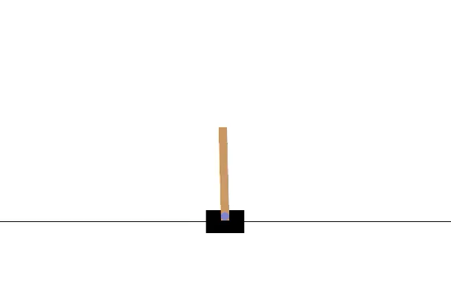

Env: Cart Pole
[Training]
Episode 100~200 (Average steps: 60.6)
Episode 200~210 (Average steps: 144.6)
Episode 500~510 (Average steps: 282.0)

Slide 31
IV. DDPG

Slide 32
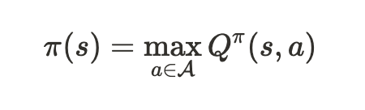
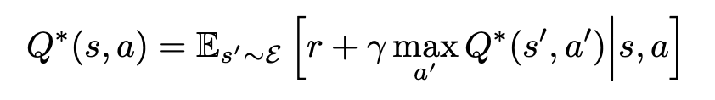
DQN vs DDPG
DQN
Designed for environments with discrete action spaces
A Q-network alone is sufficient for learning the policy
DDPG
Suitable for environments with continuous action spaces
Requires both a policy network (Actor) and a Q-network (Critic)

Slide 33
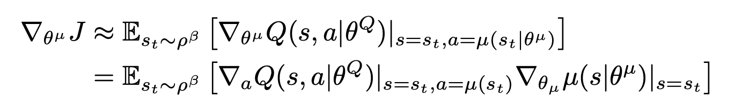
Deterministic Policy
Deterministic policies simplify the computation of gradients during the optimization of the policy network.

Slide 34
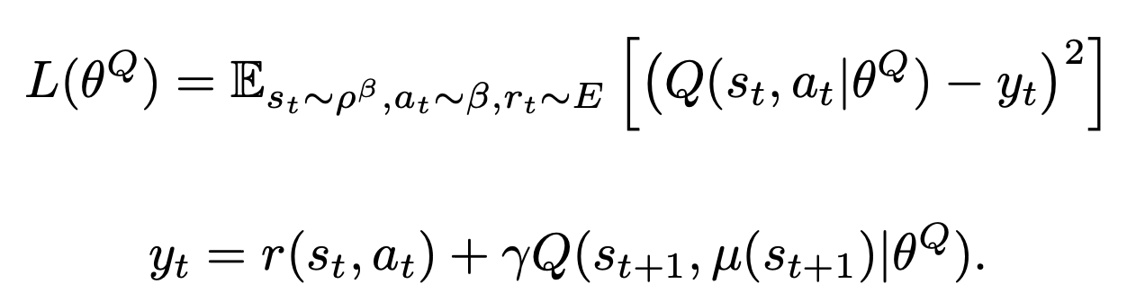
Critic
The critic network receives the state and action as input and produces the corresponding Q-value as output.
Critic
Network
$$Q(s,a)$$
State s
Action a

Slide 35
Actor
The actor receives the state as input and produces the appropriate action for the agent.
Actor
Network
State s
Action a

Slide 36
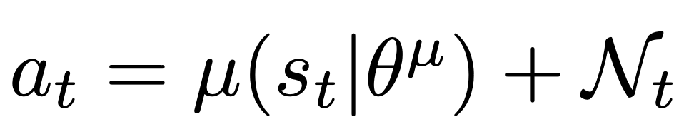
Implementation details
Due to the deterministic nature of the policy, the agent may fail to explore enough, which can hinder effective training.
Therefore, a noise component is incorporated into the agent’s policy during training, allowing the agent to explore the environment more effectively.

Slide 37
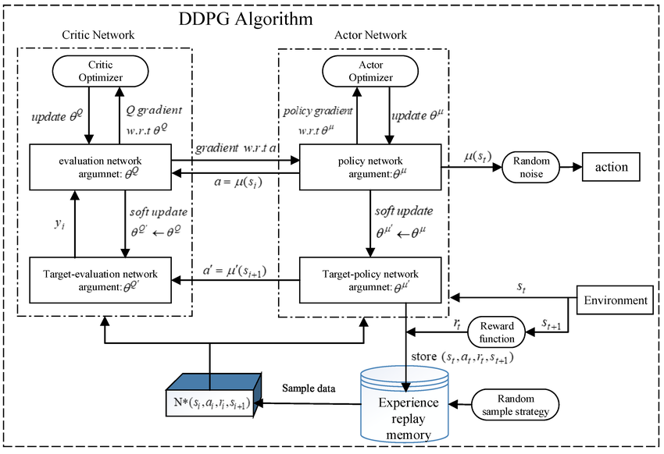
DDPG Structure

Slide 38
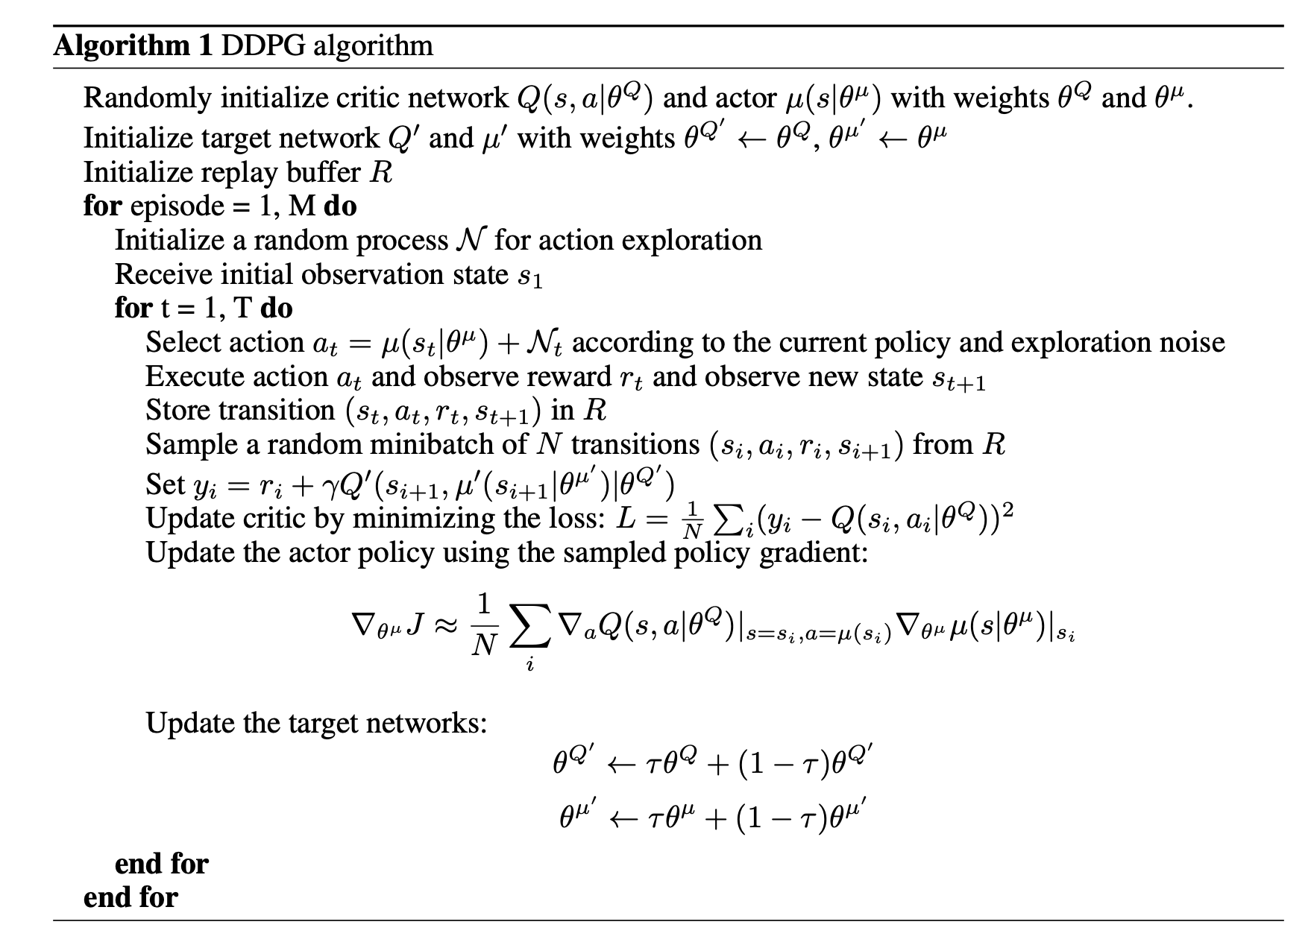
DDPG Algorithm

